Slide 1
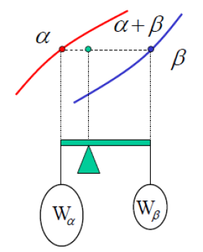
Figure 25 finding the amounts of phases using lever rule

Slide 2
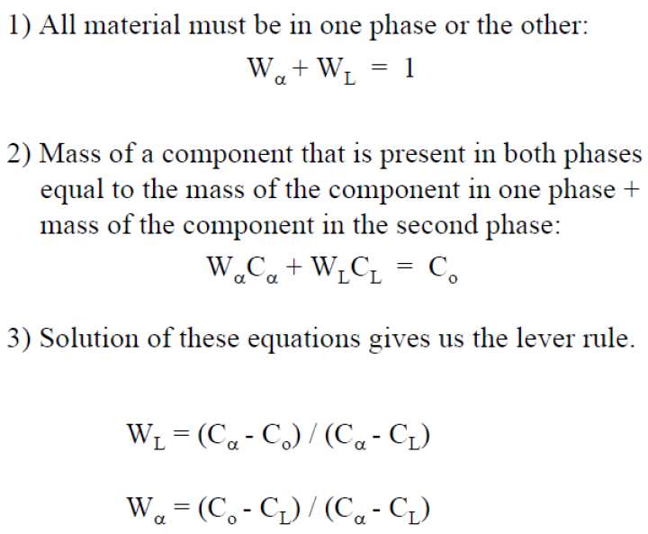

Slide 3
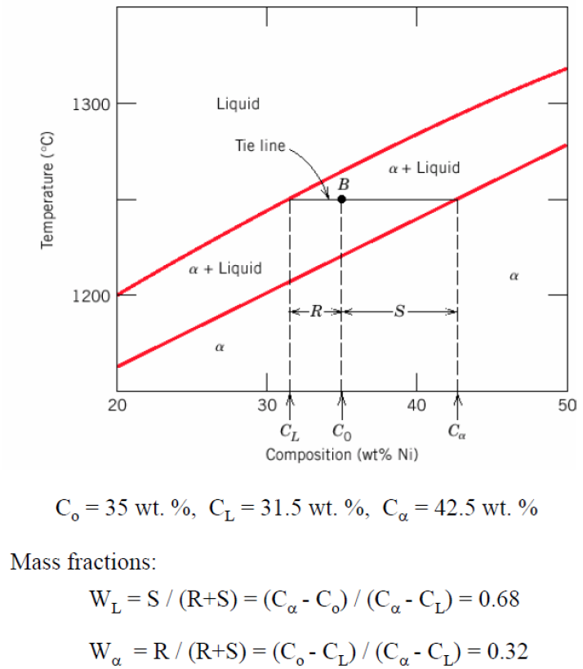

Slide 4
Example:
Calculate the amount of each phase present in 1 kg of a 50 wt.% Ni- 50 wt.% Cu alloy at a) 1400°C, b) 1300°C and c) 1200°C.
a) For a 50 wt.% Ni- 50 wt.% Cu alloy at 1400°C, we are in the liquid (L) region of the phase diagram. Therefore, we have 1 kg of liquid (L).
b) For a 50 wt.% Ni- 50 wt.% Cu alloy at 1300°C, we are in the solid + liquid (α+L) region of the phase diagram. Here we must use the lever rule to calculate the mass fraction of each phase. Unfortunately, figure 10.2 does not contain an insert enlarging the α+L region of the phase diagram, so accurate reading of this figure is difficult. However, if we draw a tie line across the α+L region at 1300°C, the endpoints are at about 45 wt.% Ni and 60 wt.% Ni. Therefore, the mass fractions are:

Slide 5
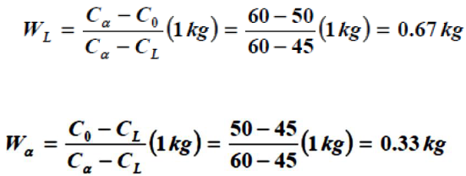
Note that when determining the mass fraction of the liquid (solid) phase, the numerator contains the composition of the solid (liquid) phase. This seems backwards to some people, and they refer to the lever rule as the inverse lever rule to remind themselves of this. To ensure that you get the correct answer, you should always look at the problem visually and determine which mass fraction is larger. Then you can check the answer. In addition, the two mass fractions (0.67 and 0.33) must add to 1.
c) For a 50 wt.% Ni- 50 wt.% Cu alloy at 1200°C, we are in the solid (α) region of the phase diagram. Therefore, we have 1 kg of solid (α).

Slide 6
6 BINARY EUTECTIC SYSTEMS
Another type of common and relatively simple phase diagram found for binary alloys is shown in Figure 26 for the copper–silver system; this is known as a binary eutectic phase diagram. A number of features of this phase diagram are important. First, three single-phase regions are found on the diagram: α , β and liquid. The α phase is a solid solution rich in copper; it has silver as the solute component and an FCC crystal structure. The β phase solid solution also has an FCC structure, but copper is the solute. Pure copper and pure silver are also considered to be α and β phases, respectively.
Thus, the solubility in each of these solid phases is limited, in that at any temperature below line BEG only a limited concentration of silver will dissolve in copper (for the α phase), and similarly for copper in silver (for the β phase). The solubility limit for the phase corresponds to the boundary line, labelled CBA, between the α /(α +β) and α / (α+L) phase regions; it increases with temperature to a maximum [8.0 wt% Ag at (779 oC )] at point B, and decreases back to zero at the melting temperature of pure copper, point A (1085 oC ).

Slide 7
At temperatures below (779 oC), the solid solubility limit line separating the α and α+β phase regions is termed a solvus line; the boundary AB between the and fields is the solidus line, as indicated in Figure 26. For the phase, both solvus and solidus lines also exist, HG and GF, respectively, as shown. The maximum solubility of copper in the phase, point G (8.8 wt% Cu), also occurs at (779 oC). This horizontal line BEG, which is parallel to the composition axis and extends between these maximum solubility positions, may also be considered a solidus line; it represents the lowest temperature at which a liquid phase may exist for any copper–silver alloy that is at equilibrium.
An important reaction can be seen for this alloy of composition CE as it changes temperature in passing through TE ;which is known as Eutectic reaction and it can be written as shown below:

Slide 8
Upon cooling, a liquid phase is transformed into the two solid α and β phases at the temperature TE; the opposite reaction occurs upon heating. This is called a eutectic reaction (eutectic means easily melted), CE and TE and represent the eutectic composition and temperature, respectively; and are the respective compositions of the α and β phases at TE .Thus, for the copper–silver system, the eutectic reaction, Equation 9.8, may be written as follows:

